Slide 1
Anticancer Assays
Dr. Sumera Javad
Dept. of Botany
LCWU

Slide 2
Cancer
Cancer is a group of diseases involving abnormal cell growth with the potential to invade or spread to other parts of the body.
Possible signs and symptoms include a lump, abnormal bleeding, prolonged cough, unexplained weight loss, and a change in bowel movements.
While these symptoms may indicate cancer, they can also have other causes. Over 100 types of cancers affect humans

Slide 3
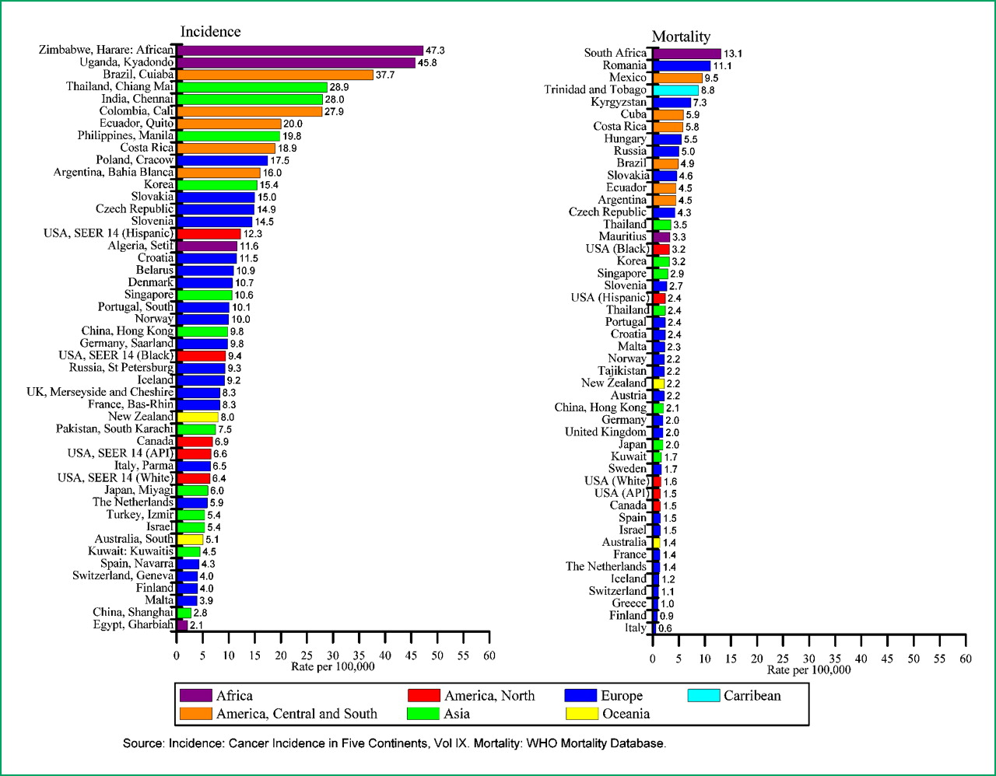
Title and Content Layout with Chart

Slide 4
Screening of antitumor compounds
We need Cancerous cells lines
Equivalence for in vitro and in vivo testing pattern
Cost of experiment
affects
Selection of cell lines
(in vivo) 3PS (P388) leukemia cells in mice
in vitro Human carcinoma nasopharyngeal cells
Lung cancer A549 cell
Breast Cancer MDA-M-231 cell lines etc

Slide 5
Differentiate
Cytotoxic
Cytotoxic to cells
May not active against cancerous cells
Cytostatic or cytocidal
Antitumor
Active in in-vivo tumor system
Anticancer
Effective against cancers in human

Slide 6
In vitro anticancer assays
Molecular assays
Cellular
Cytotoxicity
Morphological assays

Slide 7
Molecular Assays
Very much specific
Usually designed to study the mechanism of action during drug delivery
Can be used to screen compounds with specific type of activity
But
Some interesting bioactive compounds may not be detected or screened
Because they don’t have the same mechanism of action

Slide 8
Cellular assays
Usually checks cytotoxicity of compounds
Can screen a large number of bioactive compounds
But
Some compounds may be screened which are of no interest like detergents……..

Slide 9
Cytotoxicity assays
Cells and colony count assay
Macromolecular dye binding……
Metabolic impairment
Membrane integrity

Slide 10
Experimental design
Seeding density
Depends upon
Cell size
Growth rate and assay duration
Must be calculated for each cell type

Slide 11
Experimental design
drug solubilization
Stock soln. of
Polar compounds…… in water
Non polar compounds ……. In 1:1 ethanol and DMSO
Toxicity of solvent for cell line should be checked
Assay duration
usually 48-72 hours

Slide 12
Experimental design
Control wells
Medium blanks………growth medium with no cells or drugs
Drug blanks…………… growth medium with drugs but no cells
-ve control………………cells plus medium
+ve control…………….cells plus standard drugs
Test………………………..medium plus cells plus test compound

Slide 13
Commonly used cytotoxicity assays
MTT assay
Measure of cell’s metabolic activity
HCT assay
Uses human colon tumor cell lines
Used for screening of natural products

Slide 14
Anticancerous compounds from plants
Podophyllotoxin
Vinblastine
Vincristine
Amygdalin
Taxol
campothecin

Slide 15
References
"Cancer – Signs and symptoms". NHS Choices. Archivedfrom the original on 8 June 2014. Retrieved 10 June 2014.
"Cancer". World Health Organization. 12 September 2018. Retrieved 19 December 2018.
Defining Cancer". National Cancer Institute. 17 September 2007. Retrieved 28 March 2018.
Jemal et al 2010. DOI: 10.1158/1055-9965EPI-10-0437.
Hoshiba T. 2019. materials 12(8):1311.
Moraes et al 2017. book chapter “Anticancer drugs from plants” in book “Biotechnology and production of anticancer compounds, pp 121-142

